Slide 1
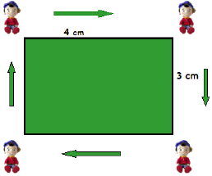
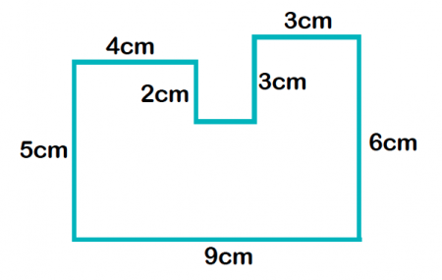
Topic: Measurement EQ: Using unit conversion how do we work out the perimeter and circumference?

Slide 2
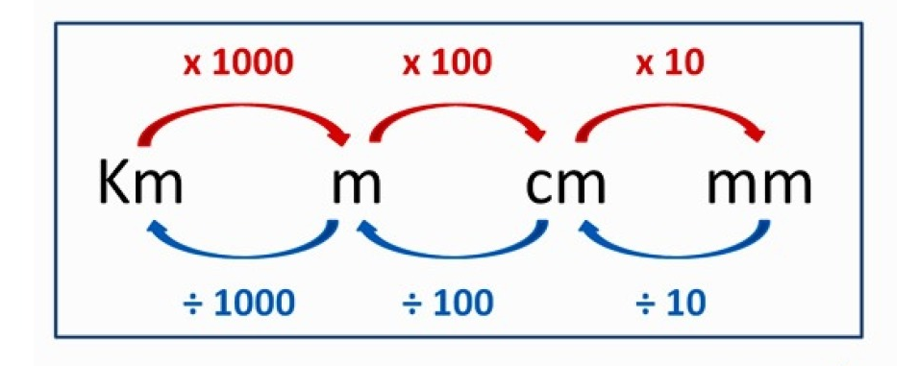
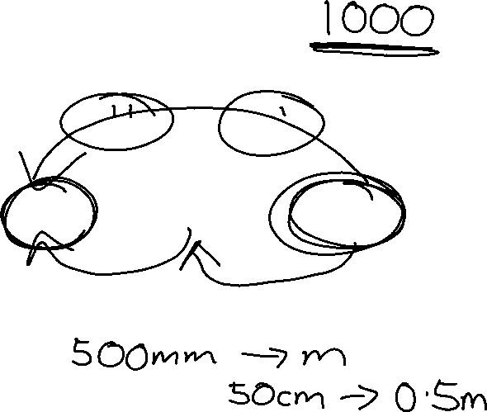
Unit Conversion
Why do we need to know how to convert units??

Slide 3
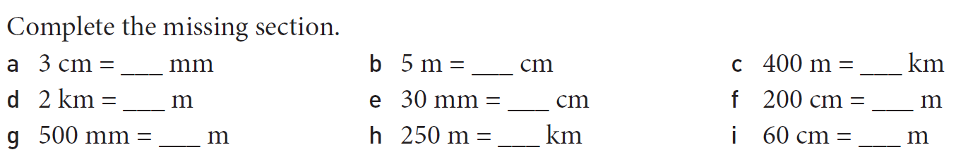
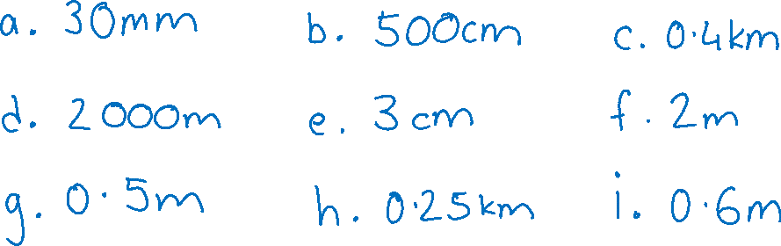
Try these….

Slide 4
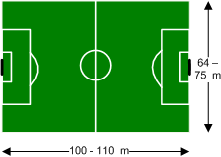
24
7
30
Date
Glossary Word
Perimeter
Perimeter
Is the distance along the boundary of a shape
Some examples:
A fence is built along the perimeter of a property
A soccer pitch has boundary lines along the perimeter

Slide 5
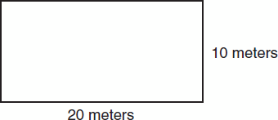
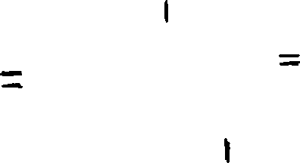
24
7
30
Date
Method
Rectangle
P = 2l + 2w
Square
P = 4l
Perimeter
To find the perimeter we add up the lengths of the sides.
P = 20 + 10 + 20 + 10
= 60 m

Slide 6
24
7
30
Date
Perimeter
Or we can use the formula P = 2l + 2w
l = length
w = width
P = 20l + 10w
= 20 x 2 + 10 x 2
= 60 m
Method
Rectangle
P = 2l + 2w
Square
P = 4l

Slide 7
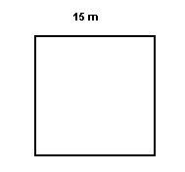
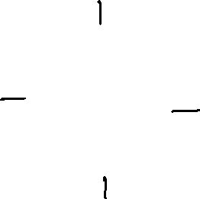
24
7
30
Date
Method
Rectangle
P = 2l + 2w
Square
P = 4l
Perimeter
P = 15 + 15 + 15 + 15
= 60 m
OR
P = 4 x 15
= 60 m

Slide 8
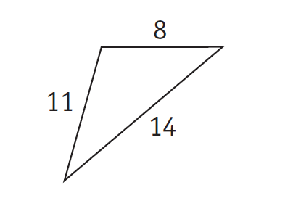
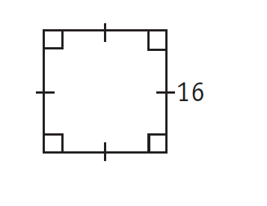
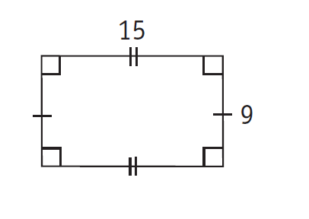
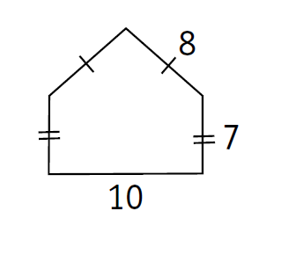
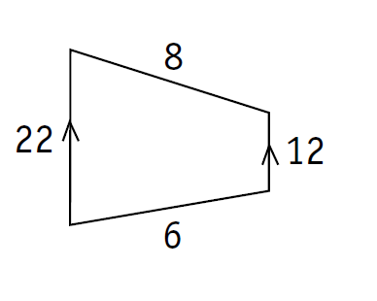
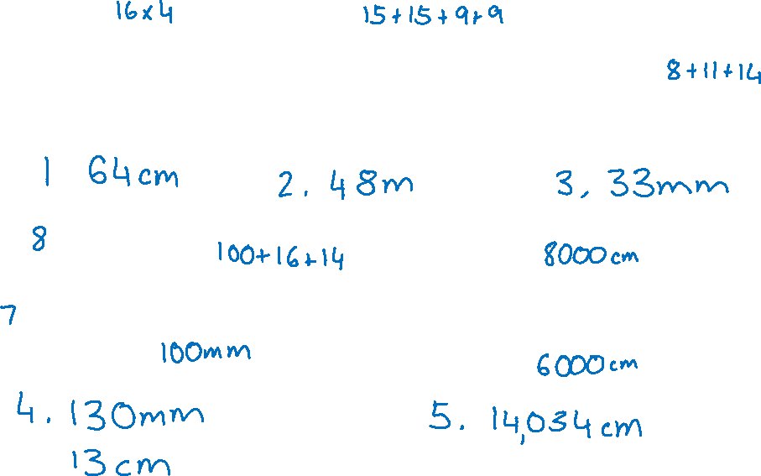
Try these….Find the perimeter

Slide 9
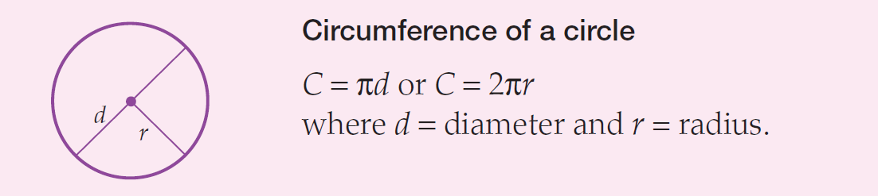
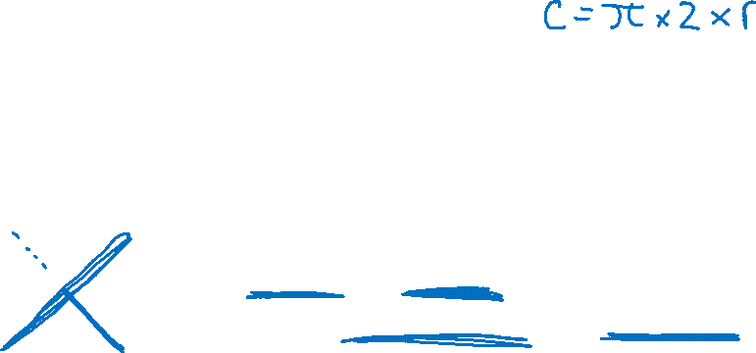
Circumference of a Circle
The perimeter of a circle is called the circumference.
If we know the circumference of a circle, we can use it to find the radius or diameter.

Slide 10
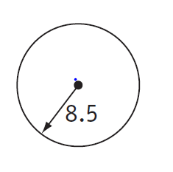
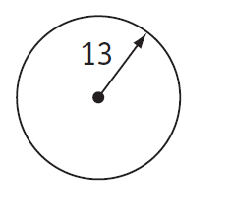
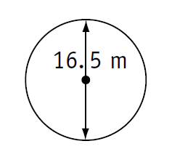
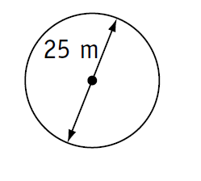
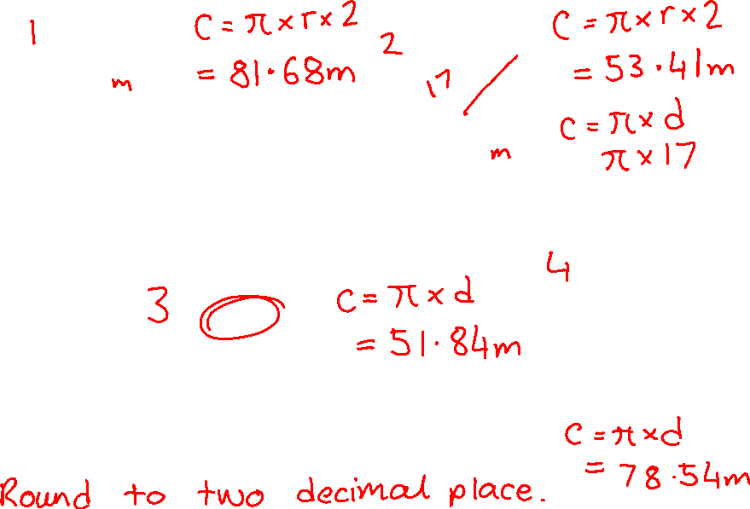
Try these…. Find the circumference

Slide 11
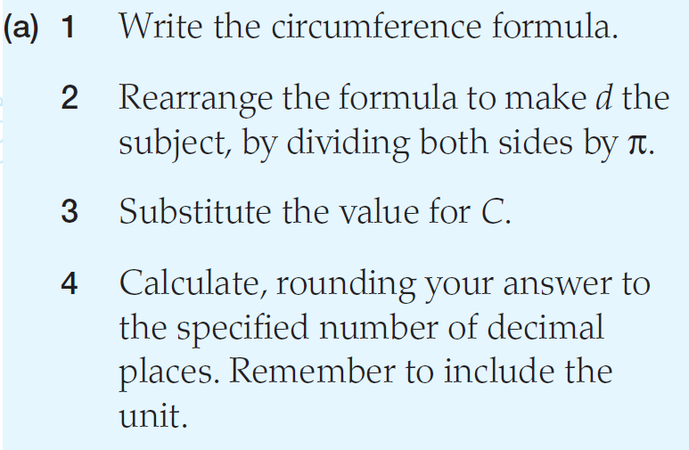
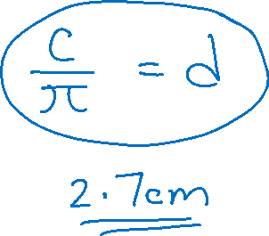
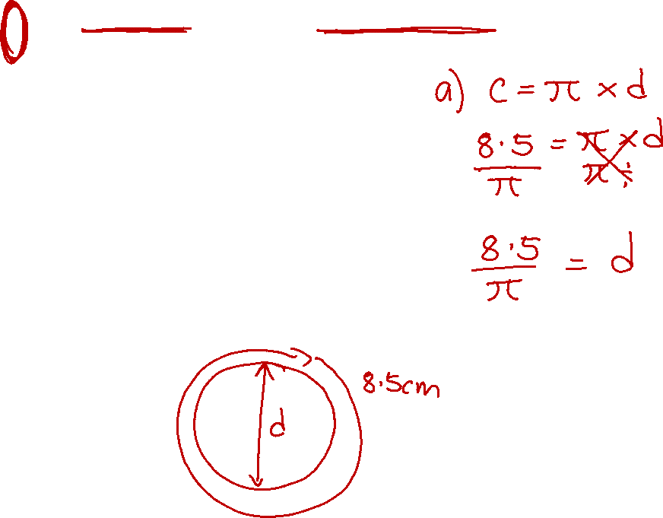

Slide 12
